Slide 1


Processing & Core (Part 2)
April 2021
Not for distribution

Slide 2
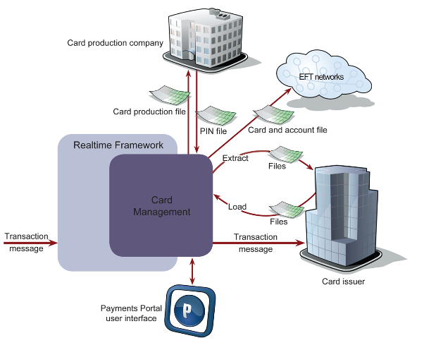
Digital Core
Producto de ACI
SDK
Modular
Multi-tenant

Slide 3
Modelos de integración – Full Autorizador
Card Issuer…
NovoPayment
Transactional Switch (Processor)
Core
VISA, MC, PROSA,ETC
Card Program A
Authorizer
Card Program…
Card
Card…
Account
Account
Account…

Slide 4
Modelos de integración – Pre validador
Card Issuer…
NovoPayment
Client
Transactional Switch (Processor)
Core
Authorizer
VISA, MC, PROSA,ETC
Card Program A
Card Program…
Card
Card…
Account
Account
Account…

Slide 5
Modelos de integración – Switching
NovoPayment
Client
Transactional Switch (Processor)
Authorizer
VISA, MC, PROSA,ETC

Slide 6


Esquema Multi-tenant
Datos
Portal
pc_issuers
pc_custom_classes
pc_auth_processors
pc_auth_pipelines
pc_system_settings
…….
ISSUER 1
pc_curtomet_1
pc_accounts_1
pc_cards_1
pc_balances_1
ISSUER 3
pc_curtomet_3
pc_accounts_3
pc_cards_3
pc_balances_3
ISSUER 2
pc_curtomet_2
pc_accounts_2
pc_cards_2
pc_balances_2
Box Owner
Financial institution 1
Issuer 1
Issuer 1
Financial institution 3
Issuer 3
Issuer 3
Financial institution 2
Issuer 2
Issuer 2
ID único para cada emisor
Abstract factory como patrón
Punto de acceso super Admin

Slide 7
Esquema Multi-tenant – Validadores y procesos
CORE
ISSUER X
Card-account lookup
Default
Custom 1
Pre-processors
Custom 1
Validators
External_processing
Post-processors
Custom 2
Custom N…
Pin_integrity
Cvr
Tvr
Card_state
Avs
Card_hold
Account_hold
Card_expiry
Pin
Cvv_cvv2
Csc
Track2
Velocity
Atc
Cryptogram
Decline
Custom 1
Custom 2
Custom N…
Custom 1..N

Slide 8
Presentación de Portal y Base de datos

Slide 9

www.novopayment.com

